Slide 1


Extracting microbial threats from big data
Robert Munro
CTO, EpidemicIQ
@WWRob

Slide 2
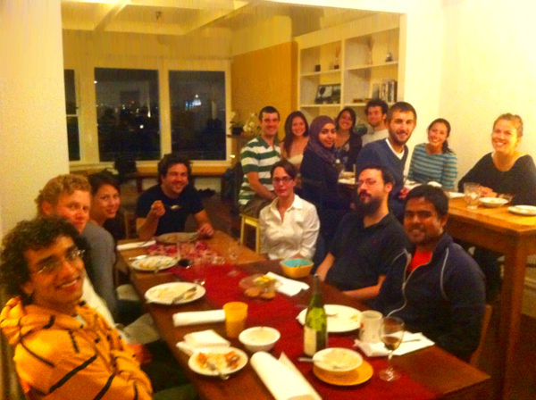
The New Virus Hunters
EpidemicIQ
@LuckOrChance

Slide 3
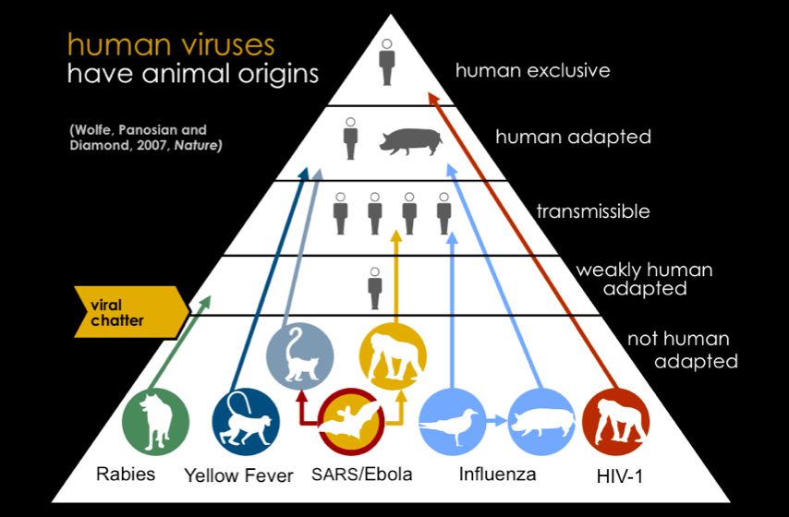
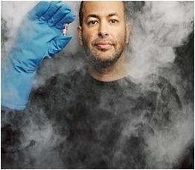
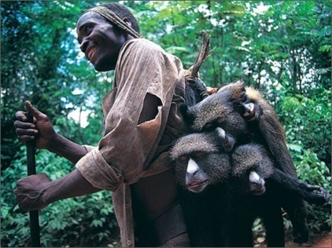
Yellow Fever

Slide 4


Slide 5
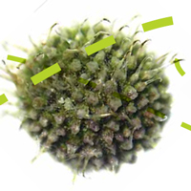
Epidemics
Greatest cause of death globally
Any transmission is a chance for deadly mutation
No organization is (yet) tracking all outbreaks

Slide 6
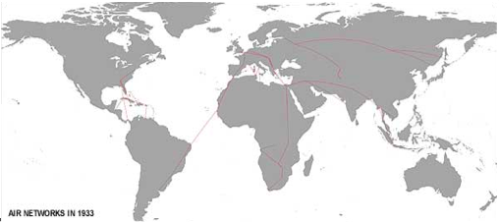
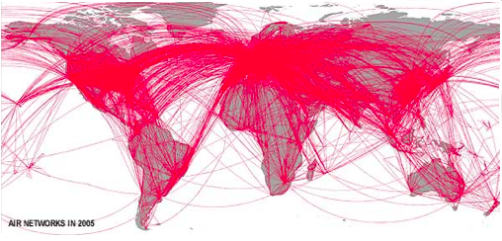
Epidemics
Eradication of diseases in the last century:
  1979: Small-pox
Progression of air-travel in the last century:

Slide 7




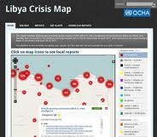

Math, Engineering, Writing, Skepticism, Curiosity, (Linguistics)

Slide 8
Daily potential language exposure
How many languages could you hear on any given day?
How has this changed?
# of languages
Year

Slide 9

Daily potential language exposure
# of languages
Year

Slide 10
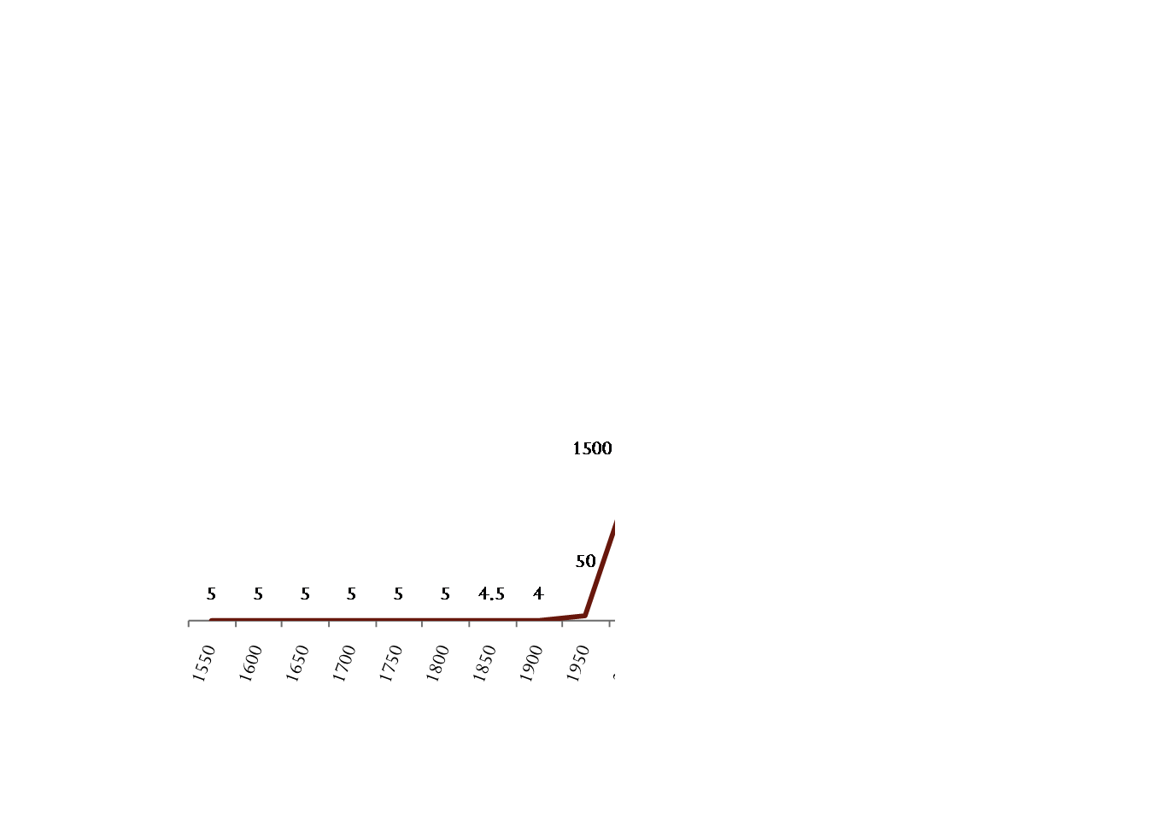
Daily potential language exposure
# of languages
Year

Slide 11
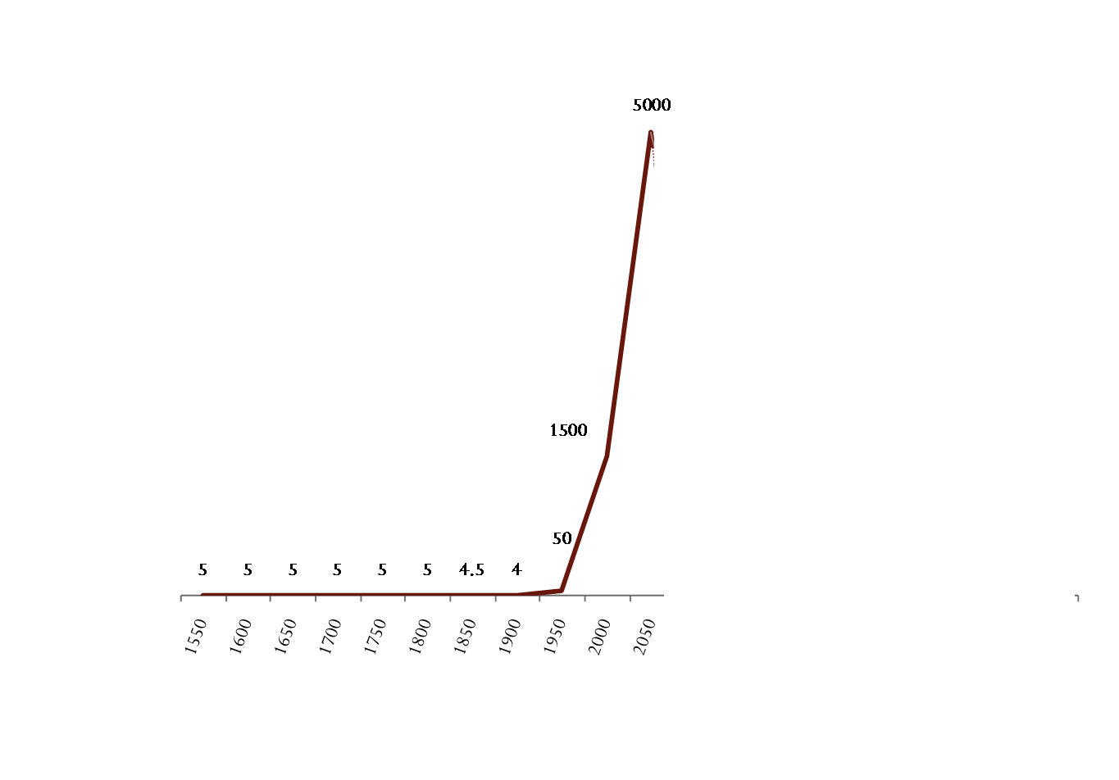
Daily potential language exposure
# of languages
Year

Slide 12
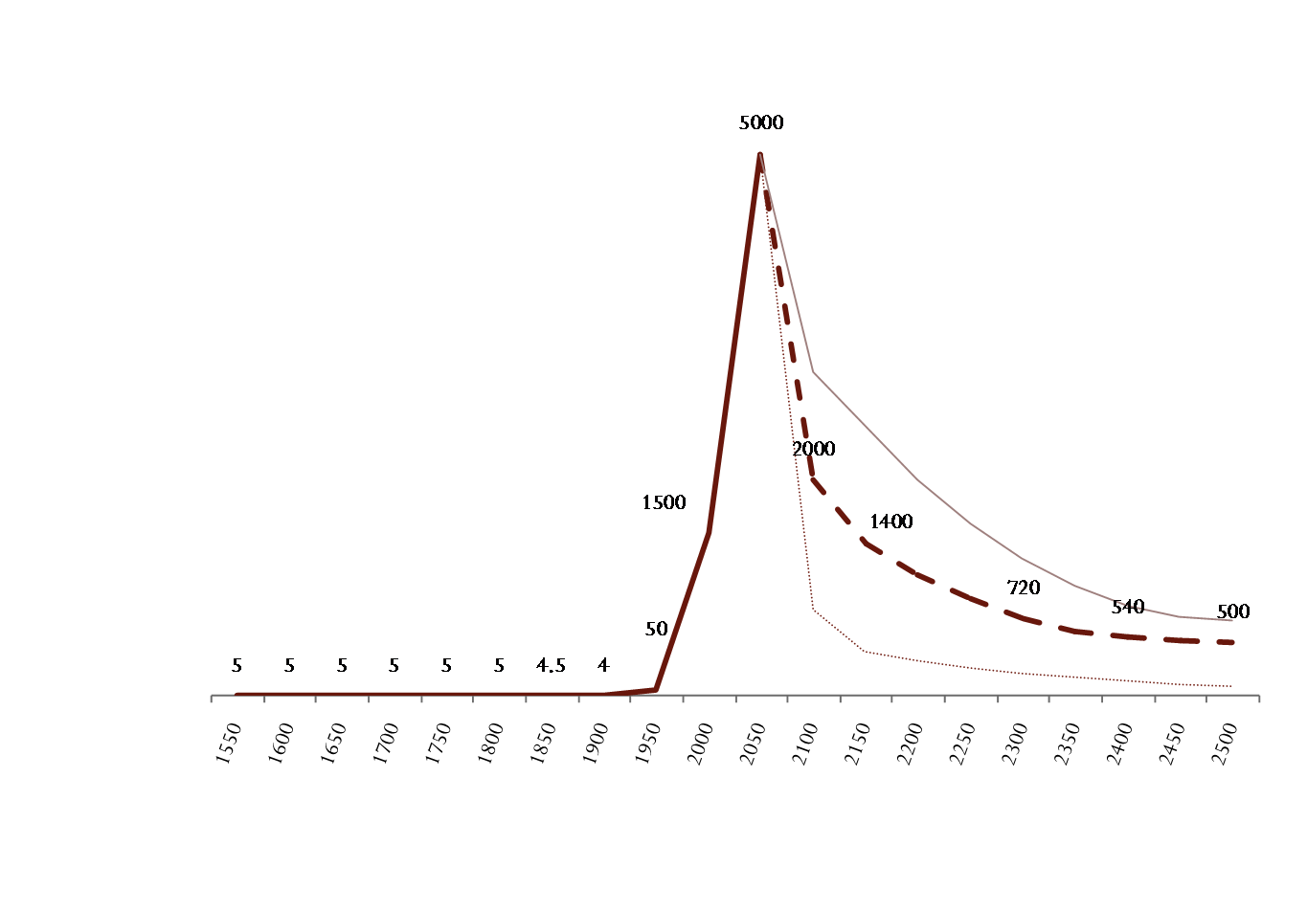
Daily potential language exposure
Our potential communications will never be so diverse as right now
# of languages
Year

Slide 13
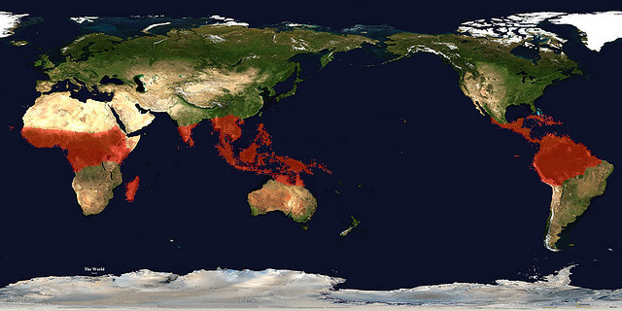

The communication age
90% of the world’s ecological diversity
90% of the world’s linguistic diversity

Slide 14
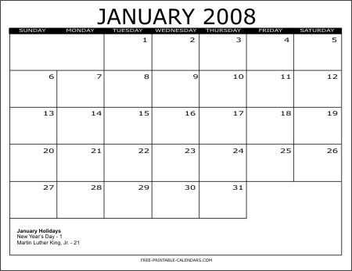

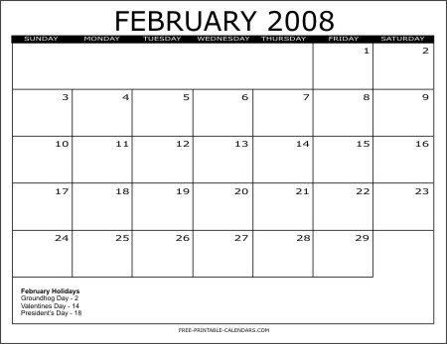

CDC vs Google Flu Trends?

Slide 15
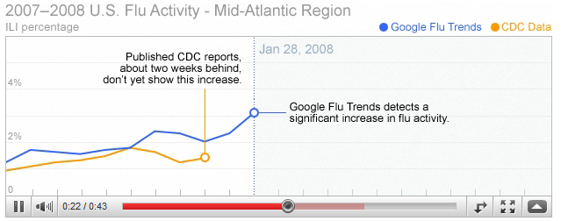
CDC vs Google Flu Trends?
Source: http://www.google.org/flutrends/

Slide 16


CDC vs Google Flu Trends?
Traditional Media?
"I'm Jacqui Jeras with today's cold and flu report ... across the mid- Atlantic states, a little bit of an increase here”

Slide 17
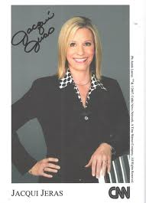

CDC vs Google Flu Trends?
Traditional Media?
"I'm Jacqui Jeras with today's cold and flu report ... across the mid- Atlantic states, a little bit of an increase here” Jan 4th
Winner !

Slide 18
The first signal is linguistic
Every outbreak predicted by Google Flu Trends has been preceded by open, online reports
The same is true for all other search-term-based disease predictions
NB: Google Flu Trends members have also discovered this!

Slide 19
The first signal is linguistic
“Improved Response to Disasters and Outbreaks by Tracking Population Movements with Mobile Phone Network Data: A Post-Earthquake Geospatial Study in Haiti” Bengtsson et al. 2011.
… or you could just ask
“I am going to Jeremie next week”

Slide 20
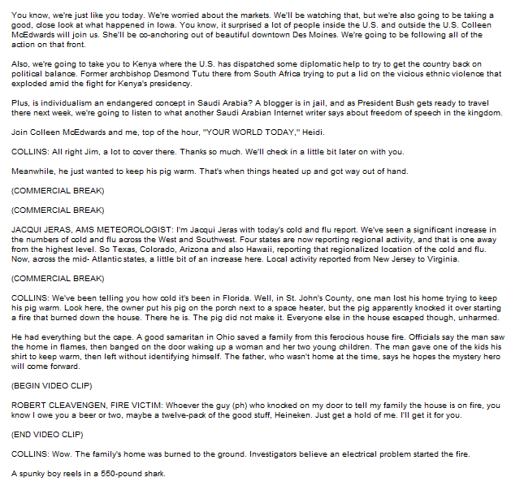
The first signal is linguistic
… but hidden in plain view
We're worried about the markets.
I'm Jacqui Jeras with today's cold and flu report ... across the mid- Atlantic states, a little bit of an increase here
we're going to take you to Kenya where the U.S. has dispatched some diplomatic help to try to get the country back on political balance.
A spunky boy reels in a 550-pound shark.
Is individualism an endangered concept in Saudi Arabia?
Well, in St. John's County, one man lost his home trying to keep his pig warm.
He had everything but the cape. A good samaritan in Ohio saved a family from this ferocious house fire.
The pig did not make it.

Slide 21
… in 1000s of languages
в предстоящий осенне-зимний период в Украине ожидаются две эпидемии гриппа
(2 outbreaks predicted for the Ukraine)
مزيد من انفلونزا الطيور في مصر
(more flu in Egypt)
香港现1例H5N1禽流感病例曾游上海南京等地
(Hong Kong had a case of avian influenza that traveled to Shanghai and Nanjing)

Slide 22
Reported before identification
H1N5 (Bird Flu) – weeks
H1N1 (Swine Flu) – months
HIV – years

Slide 23
HIV in the 1950s
People were:
talking locally
reporting locally
We can now access local
HIV – years

Slide 24
Outbreak information processing
Health-care professionals need to:
Evaluate reports of potential outbreaks.
Find new sources of information.
Stay ahead of the disease (especially) during information spikes.

Slide 25
Most existing solutions
Keyword-based search:
language-specific
non-adaptive
A room full of humans:
inefficient
capped-volume

Slide 26
epidemicIQ
Volume:
10x the processing of existing solutions
Greater languages / independence
Capable of short 100x spikes
Efficiency:
First evaluation in seconds
Adapts to new information in minutes
1/10 the running cost

Slide 27
“there is a new flu-like illness here”
Broad machine-processing
Targeted machine-processing
Human (manual) processing
Data input
Discovered by crawler
Maximally relevant phrases used to search more data
Direct report from field staff / partner organization
High-volume
processing
Relevance evaluated by machine learning
Information stored from the reports
Relevance evaluated by microtasker
Low-volume
processing
Sources monitor frequency updated
Reports for each outbreak aggregated
Relevance evaluated by in-house analyst

Slide 28
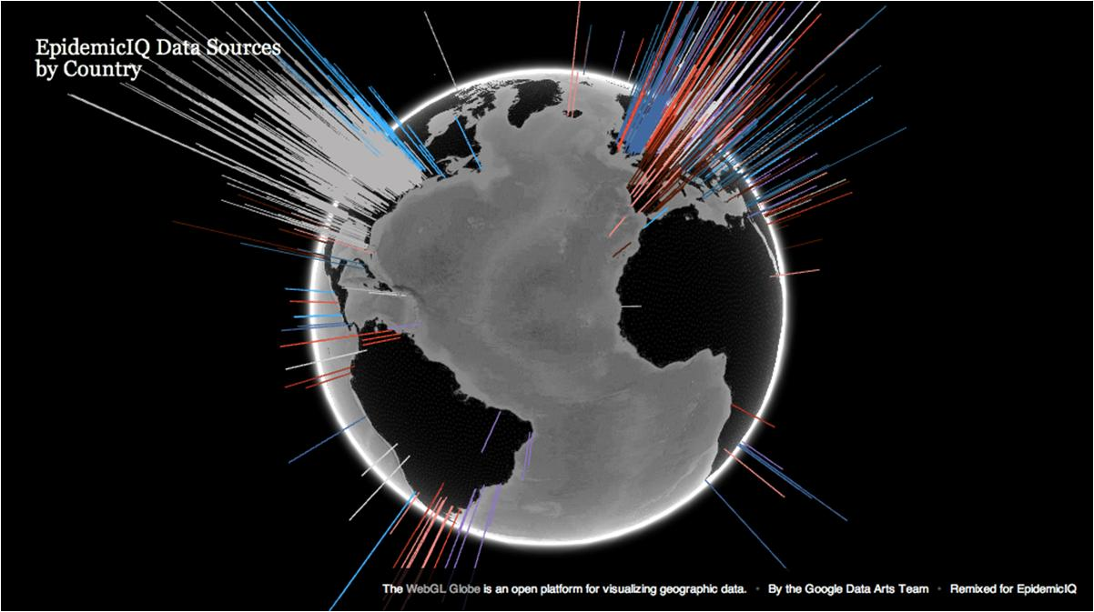
Scale – machine learning
Millions of reports daily from 100,000s sources
Stress-tested to billions per day
>70 languages

Slide 29
Scale – microtaskers
Our virtual (but real) workforce
>2,000 people from 50 nations
On many platforms (via CrowdFlower)
13 languages (English, Spanish, Portuguese, Chinese, Arabic, Russian, French, Hindu, Urdu, Italian, Japanese, Korean, German)
Stress-tested to 10,000s per day

Slide 30

Virtual good → Real good
For 600 new seeds, please answer this question:
Does this sentence refer to a disease outbreak:
“E Coli spreads to Spain, sprouts suspected”
Yes/no: __
What disease: _______
What location: _______

Slide 31
ARGUS
  “In a real-life setting, it is expensive to prepare a training data set … classifiers were trained on 149 relevant and 149 or more randomly sampled unlabeled articles.”
    Torii, Yin, Nguyen, Mazumdar, Liu, Hartley and Nelson. 2011. An exploratory study of a text classification framework for Internet-based surveillance of emerging epidemics. Medical Informatics, 80(1)

Slide 32
ARGUS
What can we extrapolate from just 298 data points?
Let’s compare 298
… to 100,000 data points
… and a purely human rule-based filtering (giving the humans infinite time)
Bernoulli Naïve Bayes
MaxEnt
20:1 relevance ratio
10% hold-out evaluation data.
20% hard cases
L1 regularization on a linear model to select 1,000 best words/sequences

Slide 33
Machine-learning evaluation
298 data points
F1 accuracy at increasing % of training data

Slide 34
Machine-learning evaluation
298 data points
F1 accuracy at increasing % of training data

Slide 35
Machine-learning evaluation
298 data points
~7% of data
F1 accuracy at increasing % of training data

Slide 36
Machine-learning evaluation
Big-data conclusions cannot be drawn from small, balanced data sets.
Chose your algorithm wisely: generative or discriminative? Changes data-collection and labeling strategies.
Natural Language Processing systems outperform rule-based systems - even highly tuned ones.

Slide 37

Targeted-search evaluation
Using the (human and machine) labeled data, we extract time-sensitive predictive key-phrases.
We leverage search APIs and our machine-learner to find new sources/reports.
How useful are the new sources of information?
@lildata

Slide 38
Targeted-search evaluation
consistent improvement,
wholly in recall
F1 accuracy at increasing % of training data

Slide 39
Targeted-search evaluation
Increases variety of report types and sources, increasing overall recall.
There is a place for search-engine-based epidemiology

Slide 40
Human in the loop
Give everything with >10% machine-learning confidence to microtaskers to confirm/reject:
  ~1000 reports per day, from 1,000,000s that the learner evaluates
Give a capped amount of persistent ambiguities to professional analysts.

Slide 41
Human in the loop
F1 accuracy at increasing % of training data

Slide 42
Human in the loop
Gives near 100% precision
Improves with the machine-learning algorithm as candidates have greater recall
95% recall in seen data
We see more reports than other orgs … but how many more are still out there?
  Good-Turing Estimates & analysts expect more

Slide 43
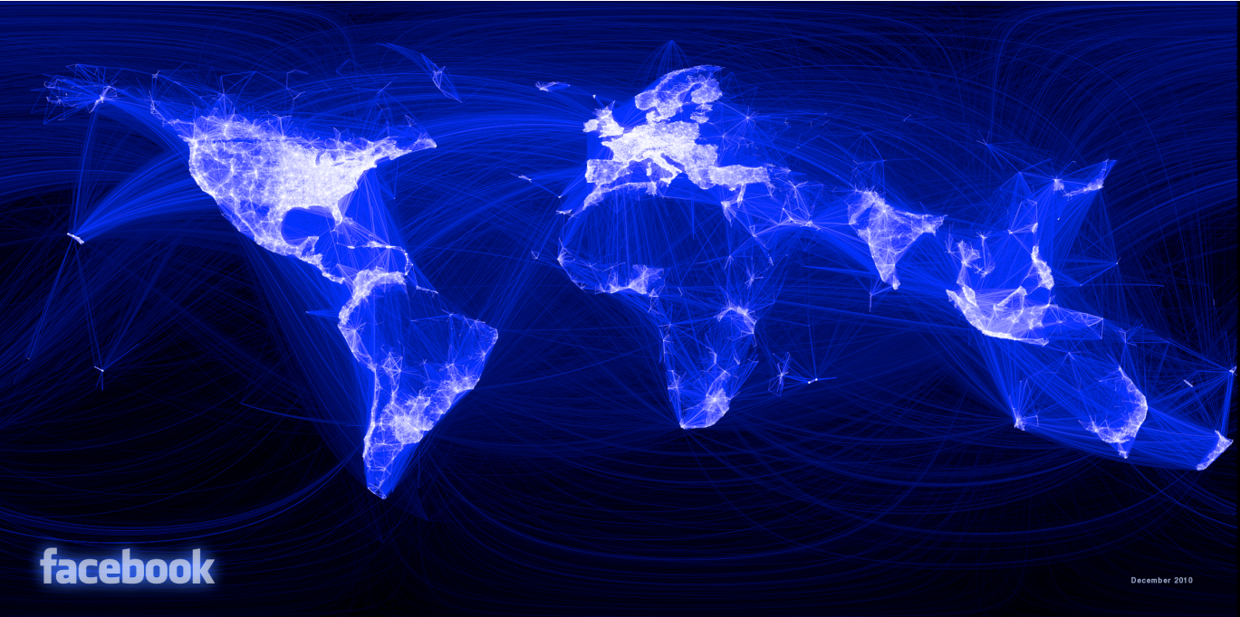
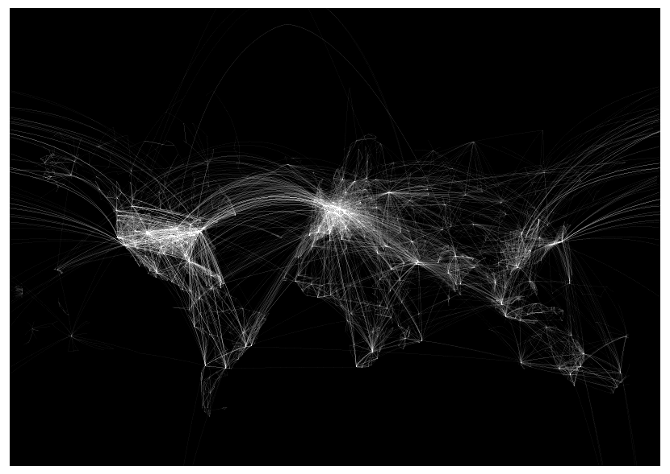
Teaser
Better
network
analysis
Transmission characteristics of H1N5:
… …

Slide 44
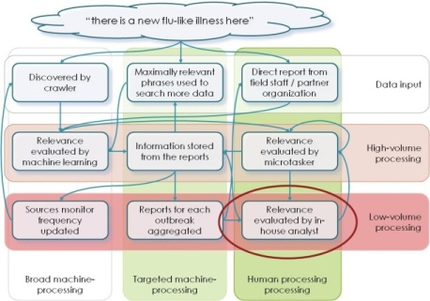
Conclusions
The earliest signals are often in plain sight, but also in plain language.
The right architecture has a place for: machine-learning/natural language processing, microtasking, targeted search and professional analysts.
@WWRob

